Slide 1
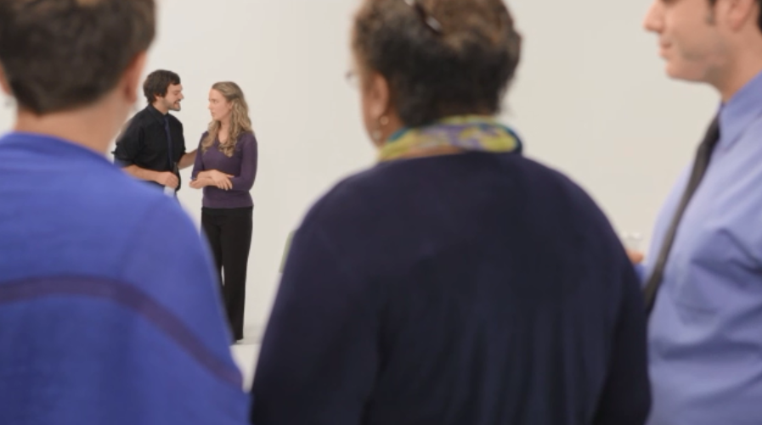
Intervene to Prevent
Sexual Violence
Notes:
We are ready to learn to intervene as bystanders to prevent sexual violence
[NEXT SLIDE]

Slide 2

5
Steps to Intervening
Notes:
There are five steps to safely intervening as a bystander…
[Next SLIDE]

Slide 3
The Five Steps to Intervening
1. Notice an event
2. Recognize there is a problem
3. Take responsibility for acting
4. Decide how to respond appropriately
5. Respond
Notes:
First, you notice an event;
Then, you recognize that action might need to be taken;
Third, you decide to take responsibility to act;
Fourth, you figure out how to safely intervene;
And lastly, you take action .
Let’s look at these in a little more detail.
[NEXT SLIDE]

Slide 4
1. Notice an event
Recognize actions or a pattern of behaviors that might signal sexual violence
What are signs?
physical or sexual aggression
pressure or coerce sexual partners
demean and sexualize women
Notes:
Step one is to notice actions or behaviors that might point to someone being a perpetrator of sexual assault.
Warning signs include someone who:
Acts physically or sexually aggressive toward another person who appears uncomfortable
Talks about having sex with others in ways that suggest they coerced or pressured their partner
Talks about women in demeaning and sexualized terms
[NEXT SLIDE]

Slide 5

1. Notice an event
2. Recognize there is a problem
Decide: action needs to be taken
If I don’t act, could the situation worsen?
IF YES, go to step 3!
Notes:
Next, you decide there is a problem that requires action.
CLICK MOUSE:
One way to decide whether the situation needs action is to ask yourself, if I don’t act, could the situation worsen?
[NEXT SLIDE]

Slide 6
1. Notice an event
2. Recognize there is a problem
3. Take responsibility for acting
    If it was my friend or family member, would I want someone to act?
    IF YES, go to step 4!
Notes:
Next, you decide to take responsibility to act.
If you aren’t sure whether to act, you might ask yourself: am I observing a behavior or action that, if I witnessed happening to a family member or close friend, I would want someone to take action to help?
[Next Slide]

Slide 7



1. Notice an event
2. Recognize there is a problem
3. Take responsibility for acting
4. Decide how to respond appropriately
Can I safely intervene?
Direct
Distract
Delegate
Notes:
Once you have decided to act, you want to consider the best way to safely intervene.
Some of the options include:
Click mouse:
Directly responding - You take responsibility as the person intervening and you confront the situation directly.
Click mouse:
Distraction - You use distraction to redirect the focus somewhere else.
Click mouse:
Delegate - You ask someone else to intervene, be it the police, security, or someone else. This might include delegating to:
Supervisors
Colleagues
Workplace security
Human Resources
Police/9-1-1
Employee Assistance Programs
Local Domestic Violence or rape crisis center
Hotline or website resources
[NEXT SLIDE]

Slide 8
1. Notice an event
2. Recognize there is a problem
3. Take responsibility for acting
4. Decide how to respond appropriately
5. Respond
Take action!
Notes:
Finally, you implement the plan you devised in step 4.
[NEXT SLIDE]

Slide 9
After you take action
GOOD JOB!
Respect Choices
Empower survivors
Notes:
After you take action, first of all you should be proud –together we can end sexual violence!
Click mouse -
There are a few things to keep in mind after you take action:
First of all, know that you aren’t responsible for the final outcome.
Respect an individual’s choices and do not take it personally if they respond differently than you anticipated.
Domestic and sexual violence are crimes that take away an individual’s power and control. It is important to give power back to survivors and to trust them to make the choices that are best and safest for them.
[Next Slide]

Slide 10
Video: intervene to stop sexual violence
What behaviors signal potential sexual violence?
  What barriers might keep someone from responding?
Notes:
We will now have a chance to see an example of bystanders intervening, and then we can practice the skills ourselves.
As you watch the video, think about:
-click mouse-
What Behaviors you see that might indicate potential sexual violence
-click mouse-
And, what barriers might keep someone from responding?
We will then discuss those questions as a group.
[NEXT SLIDE]

Slide 11
Click link to view video
Or view on Youtube at http://youtu.be/3FzNhHcyZuI
Notes:
video is embedded in slide, hover over bottom left corner and press play.
If the video doesn’t stop and plays again, just hit Escape and then proceed to next slide
***IF YOU PREFER TO VIEW VIDEO ON YOUTUBE:***
The video link is located at the bottom of the slide, at: http://youtu.be/3FzNhHcyZuI

Slide 12

1. Notice an event
2. Recognize there is a pr
3. Take responsibilifor acting
4. Decide how to
5. Respond
STEP 1: NOTICE POTENTIAL SEXUAL VIOLENCE
What signs did you notice?
Notes:
[To group] What were some of the signs you noticed?
(Brainstorm as a group. Once done, proceed to next slide to see our full list.]
[NEXT SLIDE]

Slide 13
1. Notice an event
2. Recognize there is a pr
3. Take responsibilifor acting
4. Decide how to
5. Respond
STEP 1: NOTICE POTENTIAL SEXUAL VIOLENCE
  What were some of the signs you noticed?
  Physical/Sexual aggression
  Use of alcohol
  Spoke in demeaning way about female boss
Notes:
Here is a list – let’s see if we missed any or noticed any that are not on the list:
Physical/Sexually aggression– invaded personal space and seemed persistent in sexually pursuing several colleagues.
Use of alcohol – In both instances sought to give alcohol to his colleagues. (Remember: Alcohol does not cause sexual violence. However, perpetrators often target individuals who may be incapacitated due to alcohol, and alcohol is the most common drug used to facilitate rape.
Spoke in demeaning way about female boss–Not everyone who makes demeaning jokes is a perpetrator of violence, but in this case the individual had a pattern of behaviors that showed disrespect toward his female colleagues.
Once you have noticed the signs, you then decide whether action needs to be taken….
[NEXT SLIDE]

Slide 14
1. Notice an event
2. Recognize there is a problem
4. Decide how to respond appropriately
5. Respond
STEP 2: THERE IS A PROBLEM THAT NEEDS ACTION
could the situation worsen?
Notes:
At this point you ask yourself, If nobody acted, could the situation get worse?
[To audience] What do you think?
[Next SLIDE]

Slide 15
1. Notice an event
2. Recognize there is a problem
3. Take responsibility for acting
4. Decide how to respond appropriately
5. Respond
STEP 3: TAKE RESPONSIBILITY FOR ACTING
  What barriers exist that might make someone hesitant to act?
  Concern that you are overreacting
  Concern that you might interfere with something private
Notes:
In a situation like this, what kind of barriers do you think exist that would keep someone from taking action?
(Pause to see if the audience can contribute a few – and let us know if there are some we should add to the slide based on their feedback!)
CLICK MOUSE-
Here are some that we have listed (see if there are any new ones on list)
Concern that you are overreacting – that while the colleague might not be very likable, he may not be a perpetrator of sexual violence
And
Concern that you might interfere with something private
Let’s talk about how we might overcome these barriers
[NEXT SLIDE]

Slide 16

1. Notice an event
2. Recognize there is a problem
3. Take responsibility for acting
4. Decide how to respond appropriately
5. Respond
STEP 3: TAKE RESPONSIBILITY FOR ACTING
  Concern that you are overreacting?
    action still might be welcome
    Trust gut
Notes:
CLICK MOUSE -
Concern that you are overreacting – while their colleague is not very likable, he may not be a perpetrator of sexual violence
You can’t know for sure if the situation would escalate. But at a minimum, consider whether you would want someone to come to your defense if you felt cornered or uncomfortable.
Trust your gut. If something doesn’t seem right, then it probably isn’t.
Next slide-

Slide 17
1. Notice an event
2. Recognize there is a problem
3. Take responsibility for acting
4. Decide how to respond appropriately
5. Respond
STEP 3: TAKE RESPONSIBILITY FOR ACTING
  Concern that you might interfere with something private
We all have a role in ending sexual violence
Notes:
CLICK MOUSE -
Another barrier might be concern that you might interfere with something private -
While sexual violence is a personal issue, it is time to raise the standards of how we as community respond.
Consider responding in the way we would want others to respond if it was our loved one in danger.
In the worst case scenario, if you misinterpret a situation, nobody is harmed and your colleague knows you care about their safety and well-being.
If there are barriers others brought up, that are not on slide, ask if people have ideas for how that barrier might be overcome.
NEXT SLIDE-

Slide 18

1. Notice an event
2. Recognize there is a problem
3. Take responsibility for acting
4. Decide how to respond appropriately
5. Respond
STEP 4: DECIDE HOW TO RESPOND
how would you respond?
Notes:
Think about how you might respond in this situation. We are then going to break into groups to practice intervening.

Slide 19

Practice the skills
Pair off into groups of three or four:
One person will act out the part of the potential perpetrator
One person will act out the part of the potential victim
One (or two) person(s) will act out the part of colleague(s) intervening
Notes:
For this exercise, you will want to pair off into groups of three or four (NOTE: depending on size of group you can make smaller if needed. You could use pairs – one is the perpetrator and one is the bystander)
If groups of threes:
One person will be the potential perpetrator
- One person will be the potential victim
- One (or two) person(s) will be a colleague(s) intervening
[NEXT SLIDE FOR MORE DIRECTIONS]

Slide 20
Practice the skills
DIRECTIONS:
Re-enact the scene (feel free to ad lib or change as needed for your workplace)
Switch roles and repeat.
Be prepared to discuss in small groups and report back:
What was the hardest part of responding?
The easiest?
Notes:
[READ SLIDE and keep the slide up while they do the exercise so they can refer to instructions as needed.

Slide 21
Video example: bystanders intervene
Notes:
we are now going to see an example of one way you could intervene in this situation.
[NEXT SLIDE]

Slide 22
Click to view Video
Or view on Youtube http://youtu.be/qDsXL0z8QjE
Notes:
We will now see an example of one way you can intervene as a bystander in this situation.
video is embedded in slide, hover over bottom left corner and press play.
When Video is done playing: click the Escape key and then proceed to next slide (otherwise the screen will go black and you won’t be able to advance to next slide)
***IF YOU PREFER TO VIEW VIDEO ON YOUTUBE:***
You can click on the video link at the bottom of the slide (video is at http://youtu.be/qDsXL0z8QjE)

Slide 23

video exercise: responding to potential sexual violence
  What technique did they use?
Distract
Group responded to support colleague
Notes:
Ask audience – What technique did they use?
(wait for response, then click slide)
CLICK MOUSE-
Yep, they used distraction.
They offered Carmen to join them in grabbing some food. The colleagues responded together to support Carmen.
Here, the colleagues conferred among each other and got validation with one another that the situation didn’t seem right
they worked together to figure out a way to respond that they were all comfortable with.
[Next slide]

Slide 24
video exercise: responding to potential sexual violence
  How else could a bystander respond?
Direct
Delegate
Notes:
Ask Audience: What are other ways someone could respond in this situation?
Once people mention direct or delegate click mouse
[To audience] How might you respond directly or by delegating? Any ideas?
Discuss ways you could respond directly or by delegating– here are some ideas:
Direct – here are some examples of how to directly respond:
You could directly confront Jake and say Hey Jake, I think it’s time you moved along.
You could say to Carmen, Hey Carmen, you seem uncomfortable. Do you want to come hang out with us?
Delegate
If you are not comfortable helping, find someone who is willing to help
In a work situation, if a supervisor or human resources staff member is available, ask them to intervene.
[Next slide]

Slide 25
Video Discussion
How did your bystander response differ from the video response?
Notes:
What are your thoughts about the video? How did your own response differ from the video response?
Keep in mind that there is no one way to respond.

Slide 26
I AM ONLY ONE, BUT I AM ONE. I CANNOT DO EVERYTHING, BUT I CAN DO SOMETHING. AND I WILL NOT LET WHAT I CANNOT DO INTERFERE WITH WHAT I CAN DO.
- EDWARD EVERETT HALE
Notes:
No matter how you decide to respond, know that your actions make a difference. We thank you for being a part of this training and for being part of a community that will prevent sexual assault.
NEXT SLIDE

Slide 27
Final Thoughts/Questions
Do you have any questions that we didn’t answer today?
Thank you for completing an evaluation before you go
Notes:
Does anyone have any final questions or thoughts before we warp up and fill out evaluations? Thank you again for your time and attention today!
NEXT SLIDE

Slide 28
Resources for victims of sexual violence
.
National Hotline:
1-800-656-HOPE
Sponsored by the Rape, Abuse Incest National Network, this hotline connects callers to more than 1000 rape crisis center around the country.
For a list of providers in your state or territory:
http://www.nsvrc.org/organizations/state-and-territory-coalitions
Notes:
Here is the contact information should you know anyone who might be in need of assistance.
Feel free to customize this slide and include your local rape crisis center’s contact information

