Slide 1



Domestic Violence Bystander Intervention Training
Notes:
Welcome to today’s training!

Slide 2
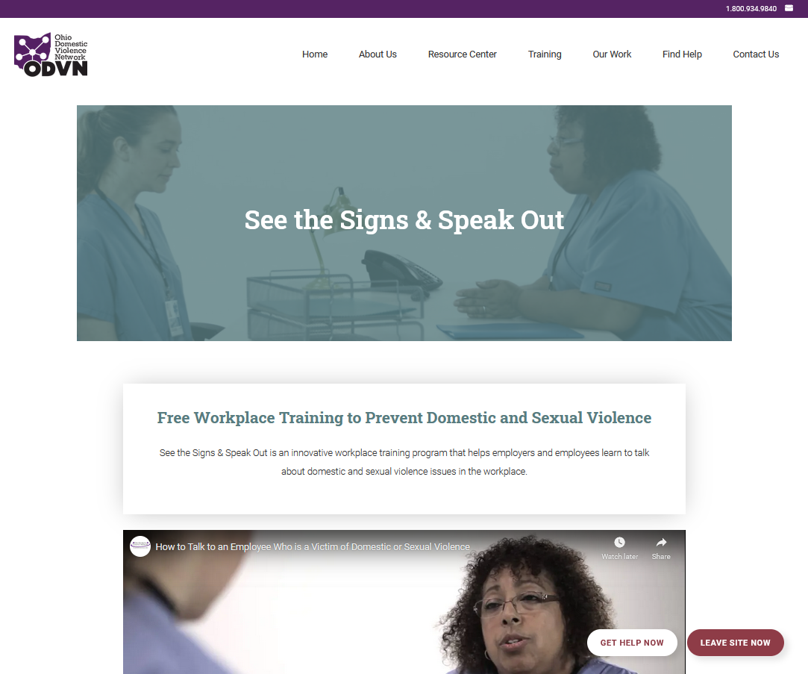
About See the Signs, Speak Out
Free, online-based trainings for workplaces
See the Signs, Speak Out
Notes:
My name is [Name] and I am the [title] at [organization/company]. I am going to be facilitating the training today.
This training is part of the See the Signs, Speak out project, which offers free trainings for employers and employees on bystander intervention.
The program offers in-person trainings (like this one) as well as Online video lessons for individuals to participate in at their own pace. You can find out more about the project at https://www.odvn.org/see-the-signs/.

Slide 3
Agenda
Intro to Bystander Intervention– 10 min
Understanding Domestic Violence– 25 minutes
How to Intervene Video and Exercise – 25 minutes
Wrap-up/Evaluation
Notes:
We are going to start with a brief overview of the goals of today’s training and a brief introduction to bystander intervention.
We are then going to take 25 minutes to answer some common questions about domestic violence
Then, we are going to watch a very short video that demonstrates bystander intervention and have a chance to practice the skills
We will then wrap up at the end and fill out evaluations.

Slide 4

By the end of today’s training you will know how to…
intervene as a bystander to prevent domestic violence
Notes:
By the end of our training today, you will know how to intervene as a bystander to prevent domestic violence. Let’s get started!
[NEXT SLIDE]

Slide 5



Ground Rules
Take care of yourself
Be respectful
Notes:
Before we dive into the material, I want to establish some ground rules for the training. I’m first going to share my two simple rules, and then if anyone wants to add to the list you will have a chance to do so.
[Click mouse]
Rule 1: Take care of yourself
I want to recognize that there may be individuals in this training who are victims of domestic violence or sexual assault and the training material may trigger difficult memories or emotions. Please take care of yourself, whether it means stepping out of the room to get fresh air, getting a glass of water, or tuning out if the material is difficult to discuss.
[CLICK MOUSE]
Rule 2: Speak respectfully
Even if you disagree, please keep your comments respectful. Please take turns when speaking.
That is it! Does anyone have any other rules they want to contribute before we get started?
[NEXT SLIDE]

Slide 6
What is Bystander Intervention?
    by•stand•er in•ter•ven•tion (\ˈbī-ˌstan-dər\ \ˌin-tər-ˈven(t)-shən\):
    Intervening if you see or hear behaviors that promote domestic and sexual violence.
Notes:
Let’s first define the term bystander intervention –
Bystander intervention is the act of someone intervening when they see or hear behaviors that promote domestic and sexual violence.
[NEXT SLIDE]

Slide 7



What’s My Role?
Notes:
At this point, you might be wondering why we are asking you specifically to intervene:
Most people do not perpetrate domestic violence, and most people are not victimized by domestic violence.
However, it is likely you know or will know someone who is directly impacted by domestic violence…
[NEXT SLIDE]

Slide 8

Become empowered to help
Notes:
1 in 4 women will be a victim of domestic violence in her lifetime, and 1 in 7 men will be victims in his lifetime.
The skills you learn today will empower you to help the people in your community who you care about.
[NEXT SLIDE]

Slide 9

You can make a difference
  After a supervisor protected confidential information:
  I felt safe and supported.
  - J. (Domestic violence survivor, age 45)
After a colleague reached to talk to a survivor of domestic violence and sexual assault, M. felt
validated, cared for [and] less isolated
challenged the negative things
the abuser said to the victim.
                - M. (Age 39)
Notes:
The skills you learn today can help you make a difference, too. A recent survey of domestic violence and sexual assault victims showed that when supervisors and colleagues reach out, victims feel safer, supported, validated, and less isolated.
[NEXT SLIDE]

Slide 10
Understanding Domestic Violence
Notes:
Before we learn to intervene to prevent domestic violence, it is important we understand what domestic violence is and the dynamics of domestic violence in a relationship.
Audience question: Have any of our participants today taken part in a training about domestic violence?
(See if anyone raises hands)
If yes: It is great to see some of you are familiar with this issue. For those of you who haven’t, we will take a little bit of time to hopefully answer questions you might have.
If NO: That is ok, today you will get a chance to become more familiar with this issue. A refresher course!
[NEXT SLIDE]

Slide 11

What is domestic violence?
What are the dynamics of domestic violence?
How does domestic violence impact workplaces?
Why do victims stay?
How can I help a victim?
Notes:
We could spend the whole session today just talking about domestic violence, but since we have a lot of ground to cover, we are going to focus on answering these five questions:
What is domestic violence?
What are the dynamics of domestic violence?
How does it impact workplaces?
Why do victims stay in abusive relationships?
How can you help someone who is a victim of domestic violence.
[NEXT SLIDE]

Slide 12
What is domestic violence?
Purposeful
Gain power and control
Deliberate behavior
Notes:
Domestic violence is purposeful and deliberate behavior aimed at gaining POWER and CONTROL over another person.
[NEXT SLIDE]

Slide 13
What is domestic violence?
Physical
Sexual
Psychological
Economic
Notes:
Domestic violence includes a pattern of coercive behaviors that might include physical, sexual, psychological or economic abuse.
[NEXT SLIDE]

Slide 14

What are the dynamics of domestic violence?
how might abusers exert power and control?
Notes:
Let’s talk about what the dynamics of power and control look like in a relationship.
TO AUDIENCE: Can you think of any examples of how abusers exert power and control? There have been a lot of stories in the media lately, so you might even draw on those examples.
(See if people suggest examples – physical violence, threats…etc.)

Slide 15
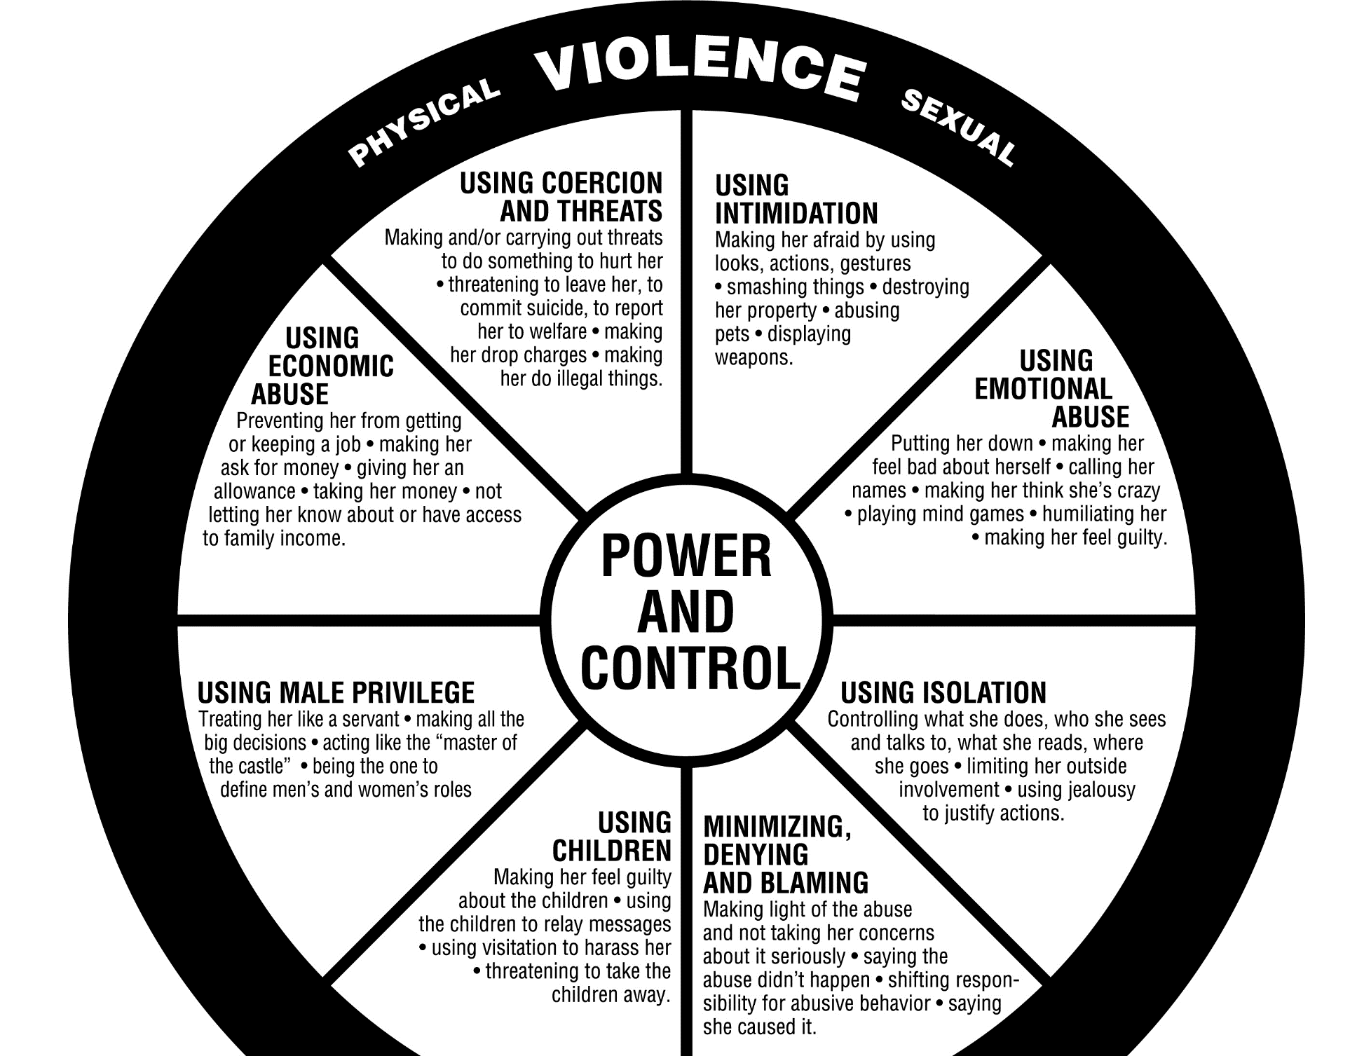
Power & Control
Wheel
  The Domestic Abuse Intervention Model, http://www.theduluthmodel.org 202 East Superior Street, Duluth MN
  ,
Notes:
NOTE: If you have the resources, before the training download and make copies of the Power and Control wheel. Pass it out to participants.
One way to visualize the various tactics that domestic abusers use to exert power and control over their partner is with a graphic called the power and control wheel. Some of the tactics you all mentioned are on this wheel.
I want to quickly note that this wheel demonstrates dynamics in a heterosexual relationship, but domestic violence can also occur between same-sex partners as well.
When we look at the wheel:
Power and control are in the center of the wheel.
The spokes of the wheel are tactics an abuser systematically uses to instill fear in a partner.
Physical and sexual violence often occurs less frequently, but holds it all together—this violence is the rim of the wheel.
Let’s see what tactics we heard mentioned – (look on wheel to see. Point out any tactics that were mentioned, and cover those tactics that were not mentioned)
[NEXT SLIDE]

Slide 16


Technology to abuse
Threats
Monitor
Stalk
Impersonate
Notes:
The use of technology to abuse is becoming more and more frequent, and this is something you might see in workplaces as well, which is why I want to mention it.
An abuser might:
Make threats via email, send disturbing info, post fake or hurtful information on blogs
Monitor or stalk the victim. An abuser might install devices on the victim’s car or install spyware on the victim’s phone to stalk and track them.
Impersonate the victim by sending email from the victim’s account, or pose as someone else when sending email or texts to the victim
[Next Slide]

Slide 17
Impacts of Domestic Violence
  64% said abuse affected work performance
  26% experienced more absenteeism
  Victims more likely to experience:
  stroke, heart disease, asthma, heavy drinking
Notes:
In addition to an abuser using work and work technology to commit domestic violence, there are ways domestic violence impacts victims at work as well.
Abuse Impacts Work Performance and Productivity:
One study found that 64 percent of victims said that the violence significantly impacted their work performance.³
Another study found that women who were victims of recent domestic violence had 26 percent more time lost to tardiness and absenteeism than non-victims.⁴
And the impact on health is great as well - Compared to women who have not experienced domestic violence, victims of domestic violence are:
80 % more likely to have a stroke
70 % more likely to have heart disease
60 % more likely to have asthma, and
70 % more likely to drink heavily¹
[Next Slide]

Slide 18


Signs in the Workplace
Notes:
As far as signs that someone in the workplace might be a victim of domestic violence, individuals may be more likely to:
Receive an unusual number of calls and have a strong reaction to these calls
Show a decrease in work productivity or work performance
Isolate him/herself at work
Have difficulty concentrating at work
[Next Slide]

Slide 19
Notes:
[SKIP SLIDE IF NO TIME]
As part of this project we conducted a survey of domestic violence and sexual assault victims and asked them how their experience impacted their work.
71 percent of respondents said that they had difficulty focusing while at work
Over half said that post traumatic stress syndrome impacted their work
Nearly half of respondent said they were not as productive at work
And a third of respondents said that they were fearful for their safety while at work.
[Next Slide]

Slide 20



Why do victims stay?
#whyIstayed
#WhyIleft
HOPE for
CHANGE
SAFETY
THREATS
Bachman, R. and Salzman, L., U.S. Bureau of Justice Statistics. Violence Against Women: Estimates From the Redesigned Survey 1. (January 2000).
Notes:
A common question is often, why does someone stay in an abusive relationship? Consider this: shouldn’t the question be, why do abusers abuse?
Let’s talk about some of the many barriers victims face when leaving an abuser:
Risk of more violence/death: A victim’s risk of getting killed greatly increases when they are in the process of leaving or have just left an abusive relationship.¹
Fear of losing custody of children
While victims fear these things all too often their fears are based in reality. All of these are risks, not just perceptions
Cultural or religious values
The abuser threatens suicide or other self-destructive behavior
The hope that the abuser changes
Lack of financial independence
To audience: Are there any other barriers you want to add?
[Next Slide]

Slide 21
Support
Validate
Listen
Refer
Respect
It’s not your fault
Notes:
When helping someone who is in an abusive relationship:
Acknowledge that they are in a very difficult and scary situation.
Remind them the abuse is not their fault.
Listen without judgment.
Refer a local domestic violence agency or a hotline
Respect decisions. Understand that there are many reasons why a victim may stay in a relationship.
[Next Slide]

Slide 22
Voices of survivors: if you could give one message to workplaces about domestic violence, what would it be?
Just listen.
- K. (female survivor of domestic violence and sexual assault, age 29)
Be supportive and understanding.
– R. (female survivor of human
trafficking/other form sexual violence, age 25)
Believe them.
-M. (female sexual
assault survivor, age 28)
Don't blame the survivor.
–C. (female survivor of
domestic violence, age 44)
Knowing you have people that care can mean everything to someone suffering from domestic violence. – S. (Domestic violence survivor, age not disclosed, emphasis added)
Thank you for participating and helping your staff. It is a huge step in the right direction! -K. (Female domestic violence/sexual assault survivor, age 46)
Notes:
As part of this project we surveyed domestic violence and sexual assault victims about their experiences in the workplace. We asked them, if they had one message for employers about how to help, what would it be? Here are a few of their responses.
-- show responses
--After last response: I just want to thank YOU again for being part of this training. You are making a difference.
[Next Slide]

Slide 23




before we learn to intervene as bystanders…
30 second stretch break!
Notes:
30 second stretch break before we dive into the bystander intervention slides!
While everyone breaks, you can open Part II of the training

